Slide 1
Problem Solving With C (PSWC) Module 4
For R and U section [2019-20 Batch]
By
Prof. Chinmay S Bhat

Slide 2
Contents
Searching
Sorting
Files
Structure array Pointers
*Hands-on sessions are available in impartus.

Slide 3

Searching

Slide 4
Introduction
Process of finding the element
Data list
Items present
Key
Value to be searched
Result
Position if key is present
Message indicating key is not present

Slide 5

Linear search
Searching element by element linearly

Slide 6
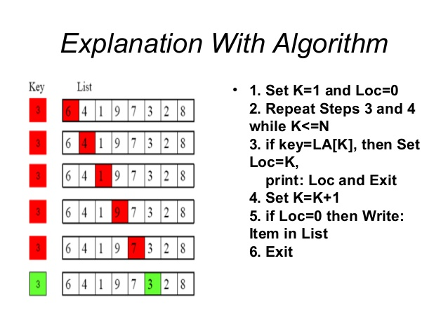
How it works?

Slide 7
Linear search implimentations
Generally used along with
Arrays
Structures
Function requirements:
Input: data list
Output: Position or -1

Slide 8
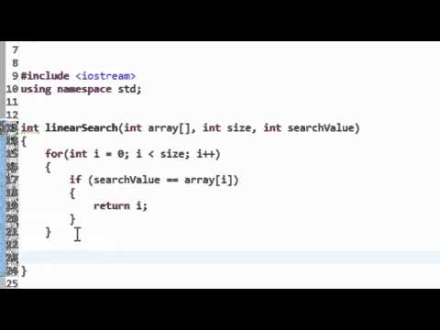
Linear search example

Slide 9
Binary Search
Linear search requires all the elements to be checked
Not efficient
If all the elements are in order:
Diving the list into half
Can skip searching one half

Slide 10
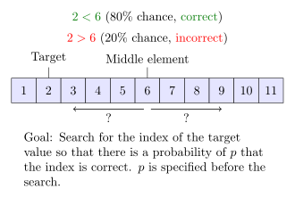
Binary Search Idea

Slide 11
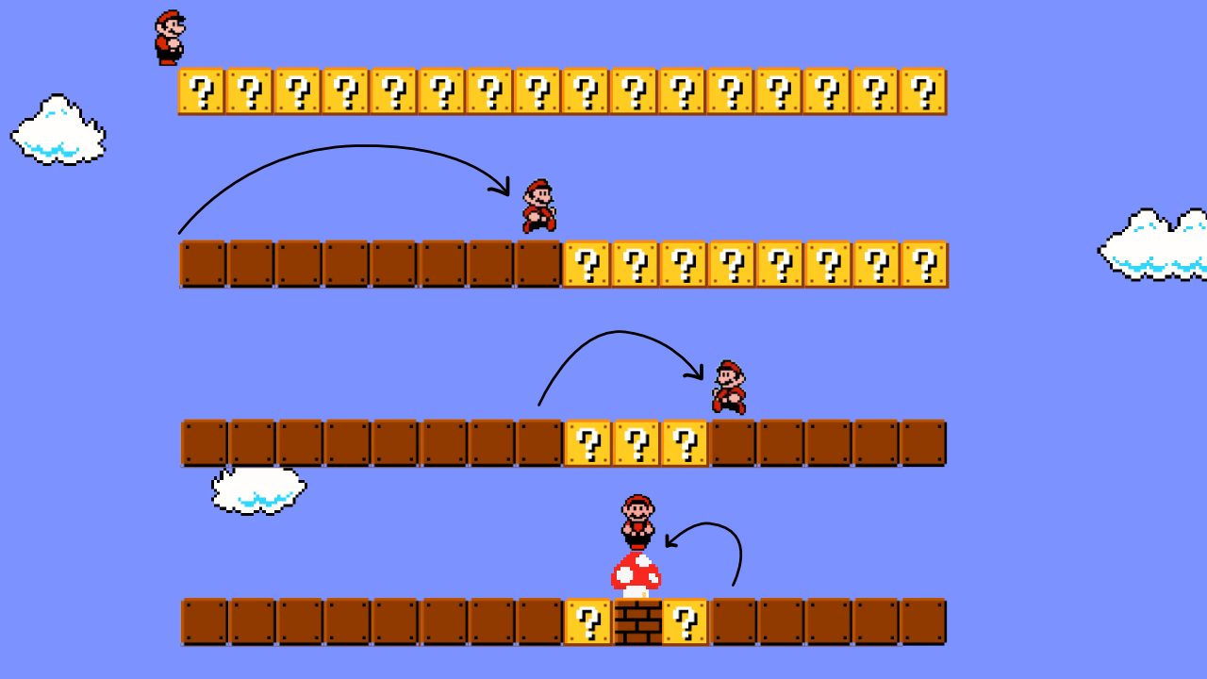
Binary Search example

Slide 12
Start , Mid and Stop(SMS)
Start and stop are the locations
Divide the array into two halves. Mid will be calculated
Check the key with mid
If equal : Stop
If greater: start=mid+1
If lesser: stop=mid-1
Continue till Start< =stop

Slide 13
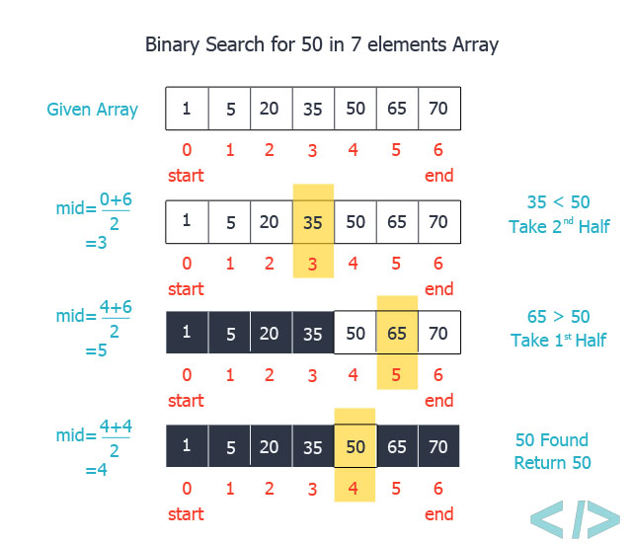
How it works?

Slide 14
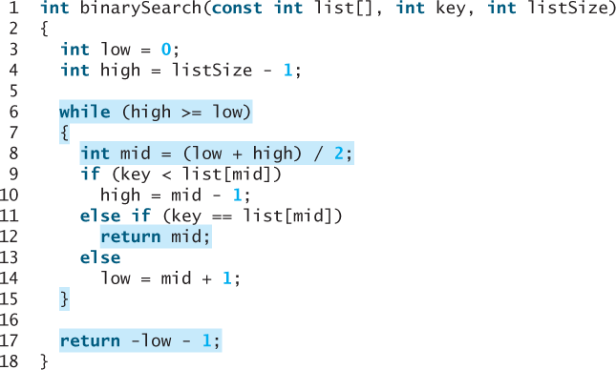
Implementation in C

Slide 15
Recursive solution
Divide the array into half
Call the same function with the half where the key is likely to be present
Keep on dividing and calling unless:
Key is found

Slide 16
Things to remember
Binary search is better than linear search in terms of performance
Limit:
All the items have to be in order
Ascending or descending
Small change in the comparison

Slide 17
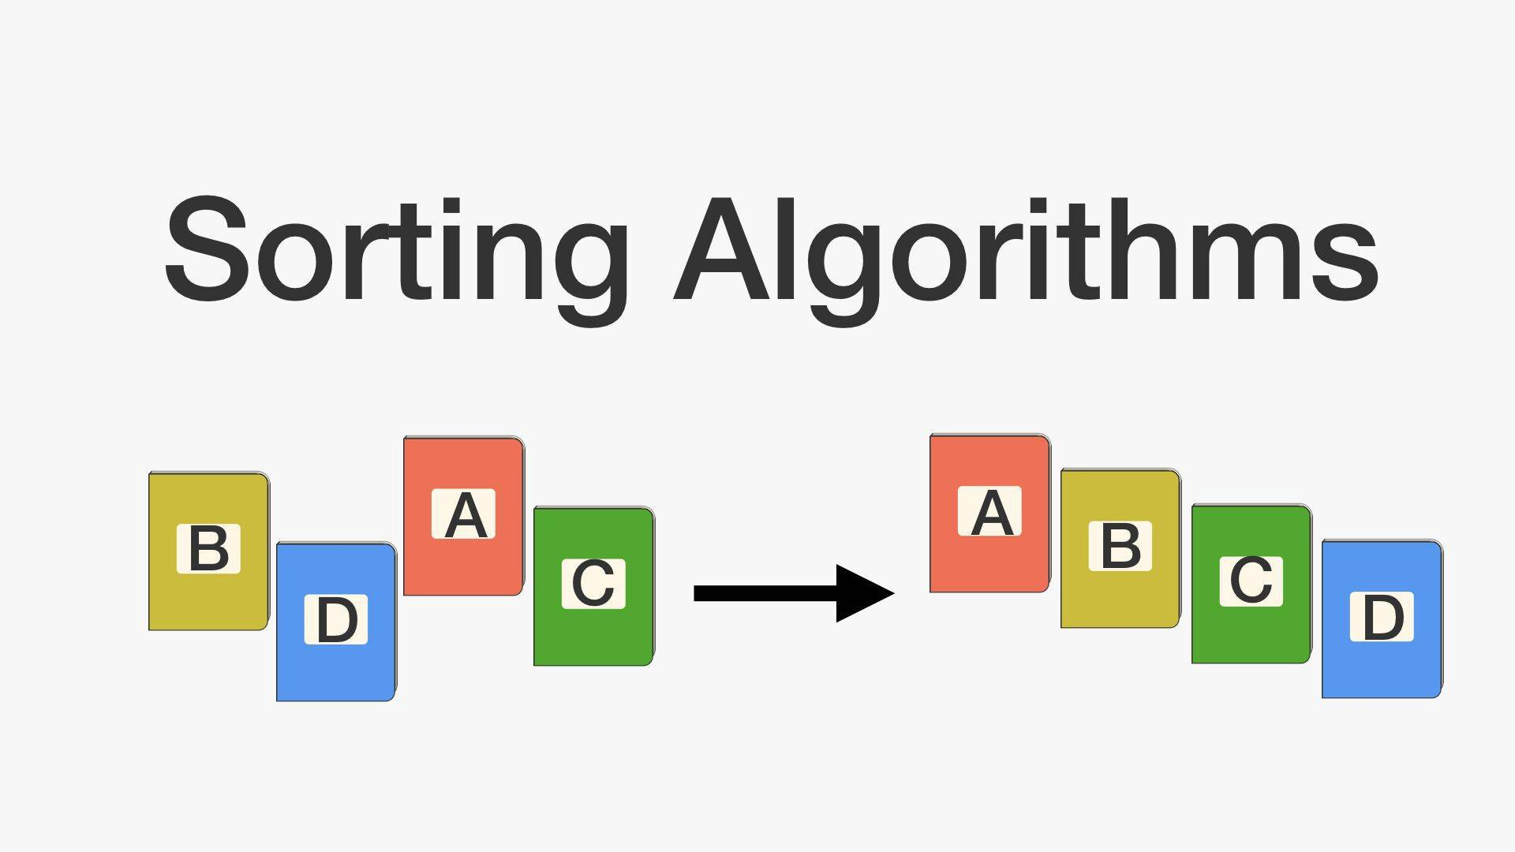
Sorting

Slide 18
Introduction
Arranging elements in order is called Sorting
Can be of two ways:
Ascending
Descending
Need for sorting:
Name list
Order Id
Arranging books

Slide 19
Types of sorting
Based on location:
Internal
External
Techniques:
Bubble sort
Selection sort
Insertion sort
Merge sort
Quick sort

Slide 20
Bubble Sort
Easiest sorting mechanism
Bubble out one element at each pass
Check with neighbor item
If greater, swap the position
N element list will need N-1 elements to be bubbled out
Two loops:
Check all the elements in the list, bubble out largest
To the same for bubbling out N-1 elements

Slide 21
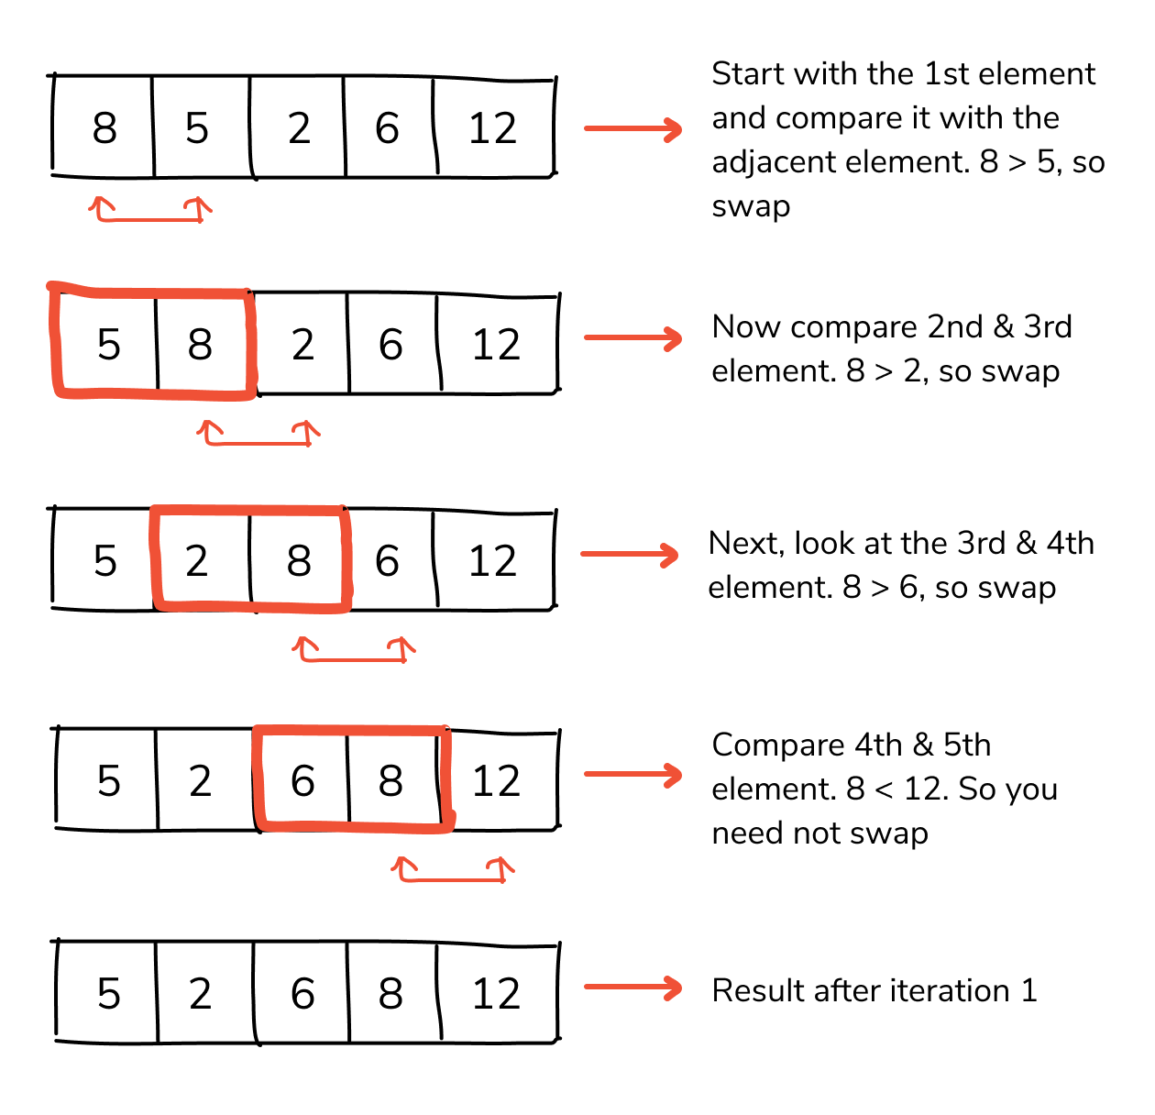
Example: Single pass

Slide 22
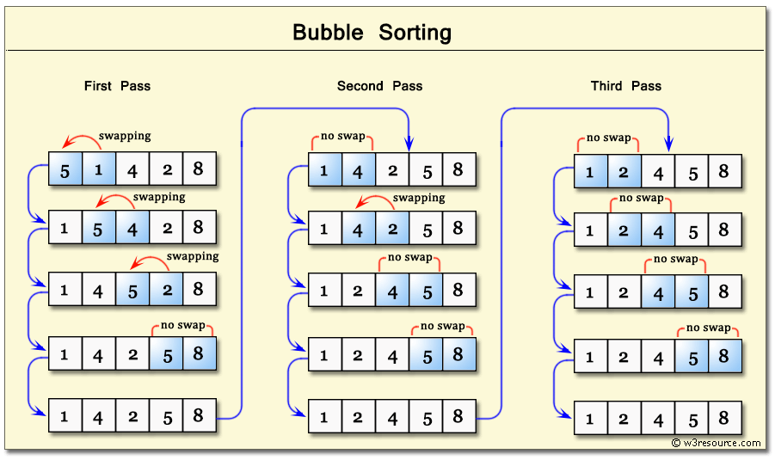
Multiple pass example

Slide 23
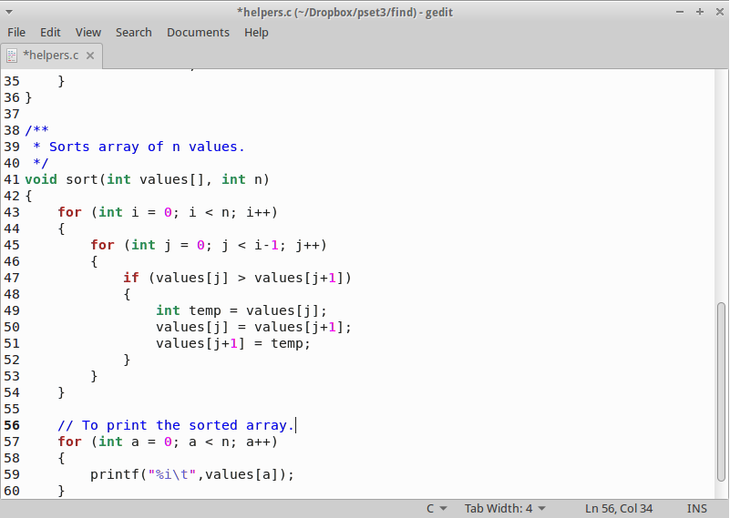
Code snippet:

Slide 24
Selection Sort
Idea:
Find the smallest element in array
Swap it to the first position
Difference w.r.to bubble sort
Swapping happens once in a pass
Finding smallest is the task at each pass
Finding smallest at each pass
Assume the first one is smallest
Change if the condition fails

Slide 25
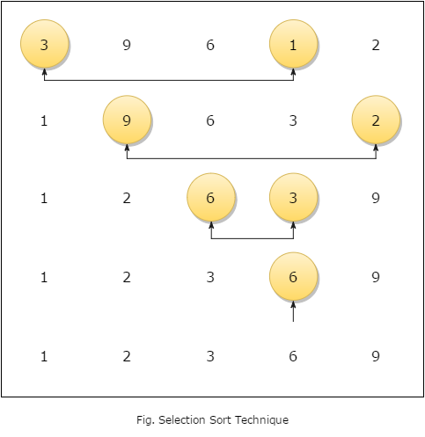
Selection Sort (Find smallest)

Slide 26
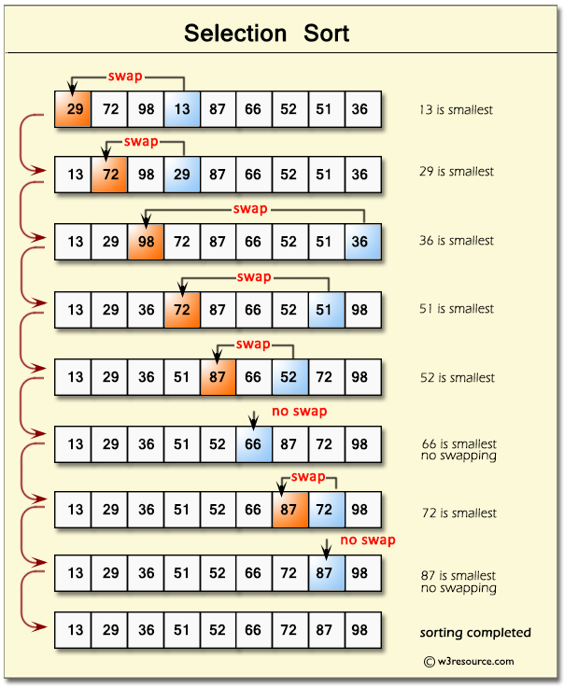
Selection sort full pass:

Slide 27
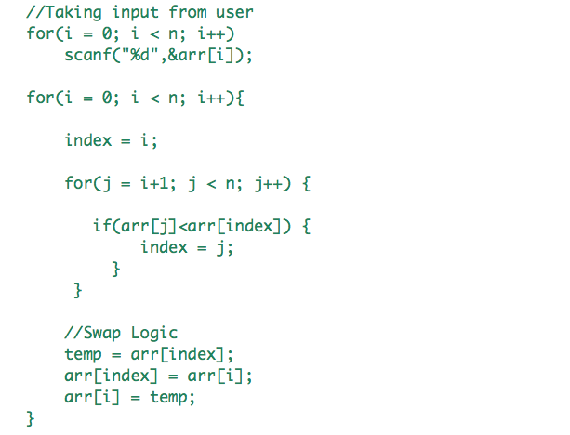
Code snippet

Slide 28

File handing in C

Slide 29
What’s wrong?
Entering data of 1000 students
Typed using keyboard
Every time have to re-enter
Can’t remember anything !
Game score ?

Slide 30
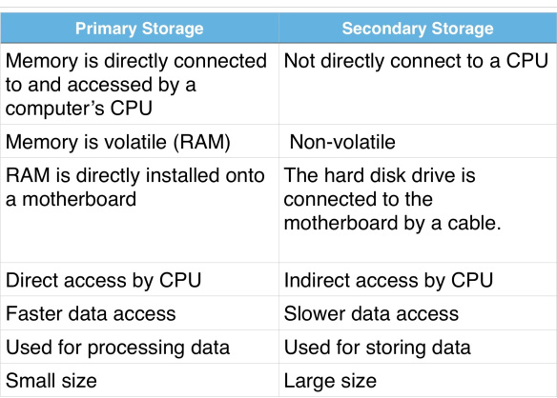
Why Files?

Slide 31
File Access in C
C program takes help of OS
OS establishes link between file and C program
This link is stored in structure variable of type FILE
Types of files
Text
Binary

Slide 32
Opening and closing files
Two parameters :
Path of the file
Mode
fopen(path,mode) is a function used
Returns a pointer of type FILE
FILE *fp=fopen(“exp.txt”,”r”);
Close the file to remove the link
fclose(fp);//fp is of type FILE

Slide 33
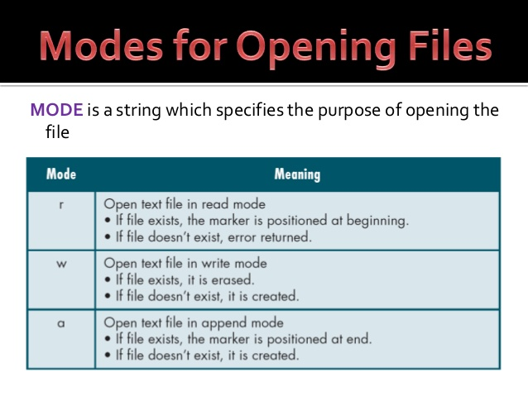
File modes

Slide 34
Simple I/O functions
Every I/O function needs
File link
Pass FILE *
Must not be NULL
Have to use the correct mode
Can’t write in read mode
fgetc(): to read single char
fputc(): to print single char

Slide 35
Significance of EOF
In String \0 denotes end of the string
Like strings , files also have to terminated after bulk reading (Loop)
EOF (End Of File) char
Functions:
feof()
Returns true if it is end of the file
Last line problem (Printing twice)

Slide 36
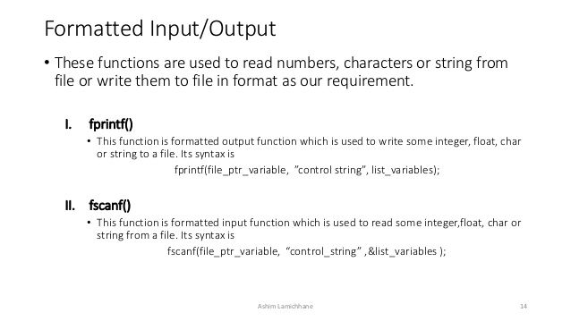
Just like printf/scanf

Slide 37
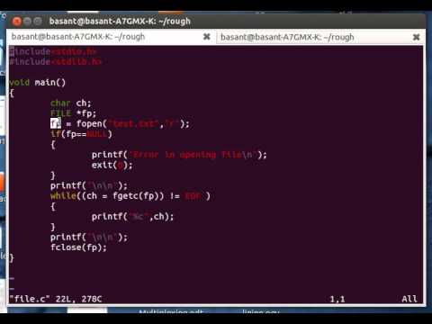
Example:Reading data

Slide 38
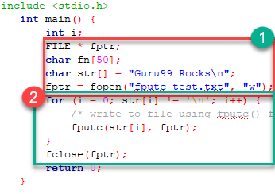
Example:Writing data

Slide 39
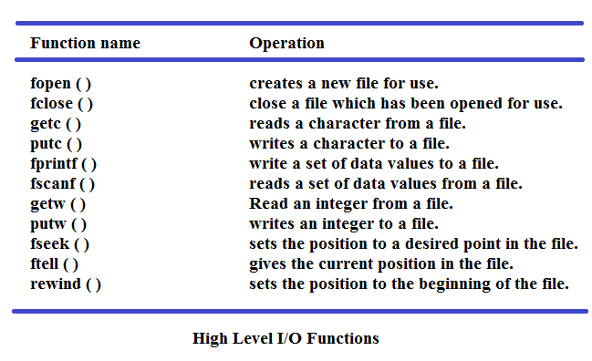
File I/O operations

Slide 40
Real world Applications
Games
Command line applications with storage
Merging two files
Compilers
Other System software

Slide 41
Structure of Array pointers
Structure
Heterogynous data
Array
Homogeneous data
Array pointers
If a[10] is an array a is points to it
‘a’ holds the starting address

Slide 42
Structure of Array pointers
More than one array to be stored as a single record
Structure of Array pointers
Array elements inside structure
Access the array by using its points
Can limit the number of structure variables
Each variable consume lot of memory

Slide 43
Example:
#define TITLE_LEN 50
#define NAME_LEN 50
typedef struct node
{
char title [TITLE_LEN];
char author [NAME_LEN];
int pub_year;
float price;
} NODE;

